Slide 1
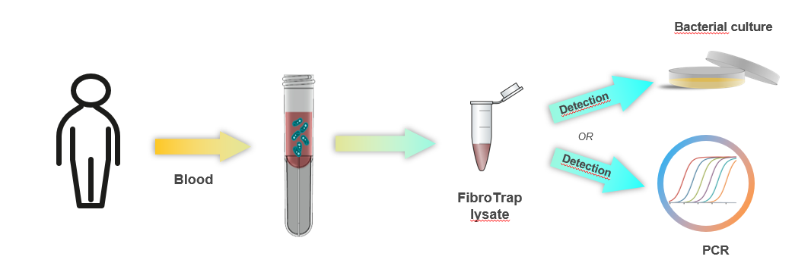
FibroTrap®
Technology Vision
A single sample prep process enabling 2 read-outs

Slide 2
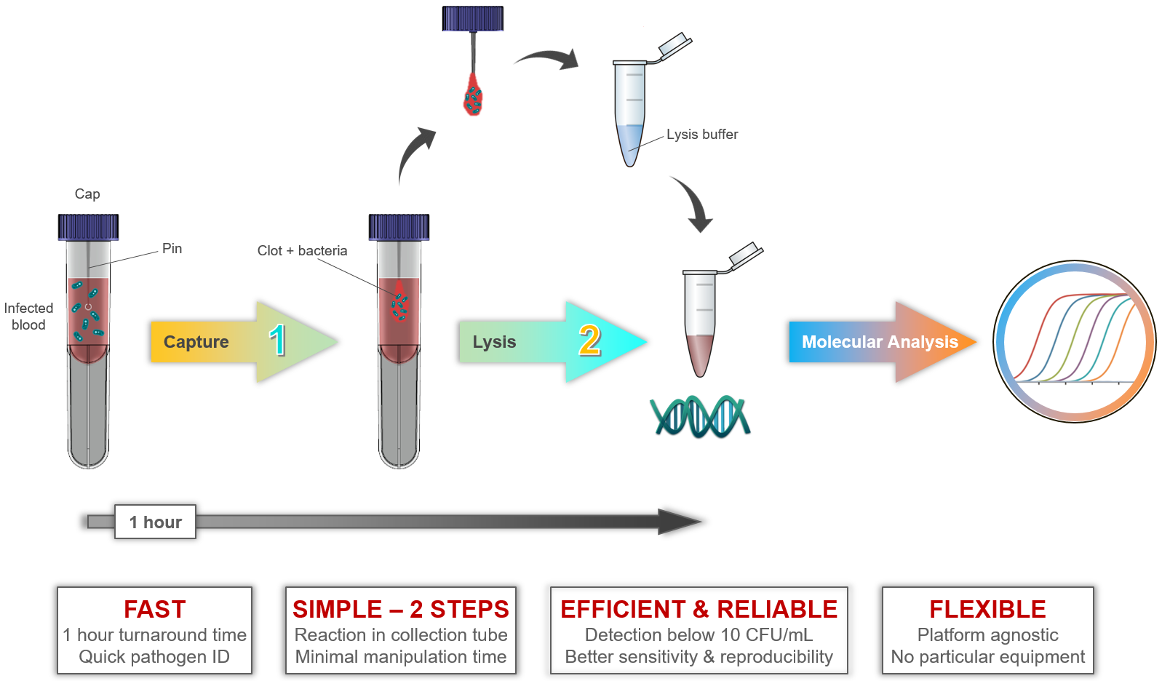
FibroTrap®
Workflow

Slide 3
FibroTrap® Clinical study
Design of the clinical study

Slide 4
Design of the clinical study
FibroTrap® Clinical study
Clinical feasibility study concluded in December 2018, with blood from BSI patients
Samples from ~1’300 patients collected and processed through FibroTrap
Conducted at ''Centre de recherche en infectiologie and Centre de recherche du CHU de Québec-Université Laval, Québec City, Québec, Canada'', (Pr. Bergeron)
https://www.debiopharm.com/drug-development/publications/new-sample-preparation-method-enabling-pcr-based-pathogen-identification-directly-from-blood-to-accelerate-blood-stream-infection-bsi-diagnosis/

Slide 5
FibroTrap®
Value Proposition
FibroTrap®, the FIRST technology to accelerate and improve diagnosis of BSI
Fast: 45’ turnaround time, sample to results < 3 hours
Innovative: unique clotting-based technology
Reliable: Low level of detection & good sensitivity/specificity
Simple: 2 steps process
Technology-agnostic: compatible with most molecular diagnostic platforms & Mass spectrometry

Slide 6
FibroTrap®
Value Proposition
Simple-to-use - 2 steps
Reduced time-to-answer - from 72h 3h
Increased sensitivity
Reduced potential hospitalization time & cost
Life-saving solution (sepsis patients)*
Right treatment for right patient (decrease resistance to treatment/ antibiotics)
High potential for additional applications (in addition to presented purpose):
  Following up antibiotics performance
  Virus detection
  Circulating DNA/RNA
  Circulating tumor cells
  Drugs
* https://www.ncbi.nlm.nih.gov/pmc/articles/PMC3488423/
https://www.sepsis.org/sepsisand/septic-shock/

